Slide 1
Password Attacks

Slide 2
Storing Passwords
Passwords should never be stored in plaintext
Also known as unencrypted
For example:
A plaintext/unencrypted password could be p@ssw0rd1@3$5^
Windows will hash this password and store it as:
4578A81E395F749BBA1D41B320F8AFFA
Linux will hash this password and store it as:
542F3706AF4A262E59A8161D7F4ED679E671E7AB2CA5B49F08308651AC9E0822E544C30C072B60FC204EAEAC118C7A875F90BBD2435CB9982D1F93AFC2F54061

Slide 3
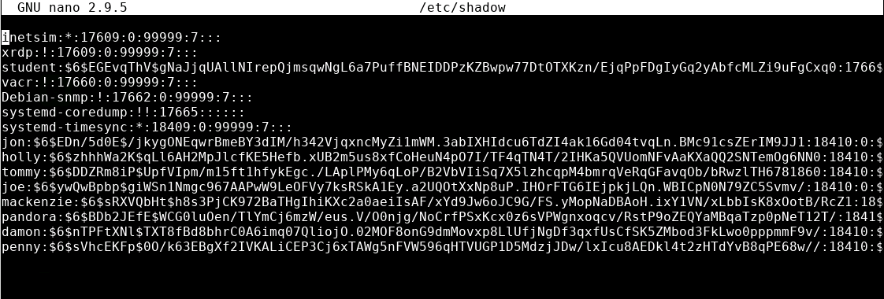
The Password File
Each OS stores passwords differently
Example: Linux /etc/shadow file

Slide 4

Brute Force Attack
Brute force = try all possible combinations and permutations until the right guess works
Like trying to guess a number by sequentially trying every number starting at 0… 1… 2…
Very slow
Many systems will lock you out after X failed attempts
Doing this offline will not lock you out
Requires password file with usernames and hashes

Slide 5

Dictionary Attacks
Most passwords are comprised of common words
If using brute force attack, try dictionary attack first. Be sure it isn’t easy-to-guess like single word from dictionary
Wordlists are available online
Made up of cracked/leaked password files from old cyberattacks
Each year, articles pop up of “Most common passwords of 20__.”
Only good against simplistic passwords
Every organization has someone that uses a weak password!

Slide 6
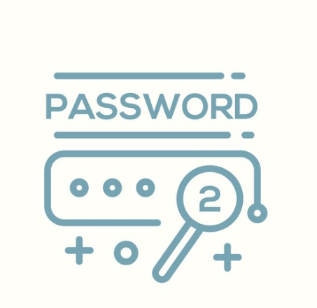
Spraying Attacks
Attempting random passwords
Very ineffective
Malicious actor hoping to get lucky
If they know the person likes Disney, they might try the following passwords:
MickeyMouse
DonaldDuck
Mickey123
M1nn1eM0use
B3ll3

Slide 7

Rainbow Tables
Pre-calculated series of hashes using known hashing algorithms
Commonly used for cracking passwords
Find the matching hash
Look up the input text that gave the result
Voila! There’s the password/input string
Rainbow table built for each application
No one table for all uses

Slide 8
Defense
Use strong passwords
Longer and more character types
Limit number of incorrect attempts
Protect the password hashes!
Do not reuse old passwords
Change passwords frequently

